Slide 1
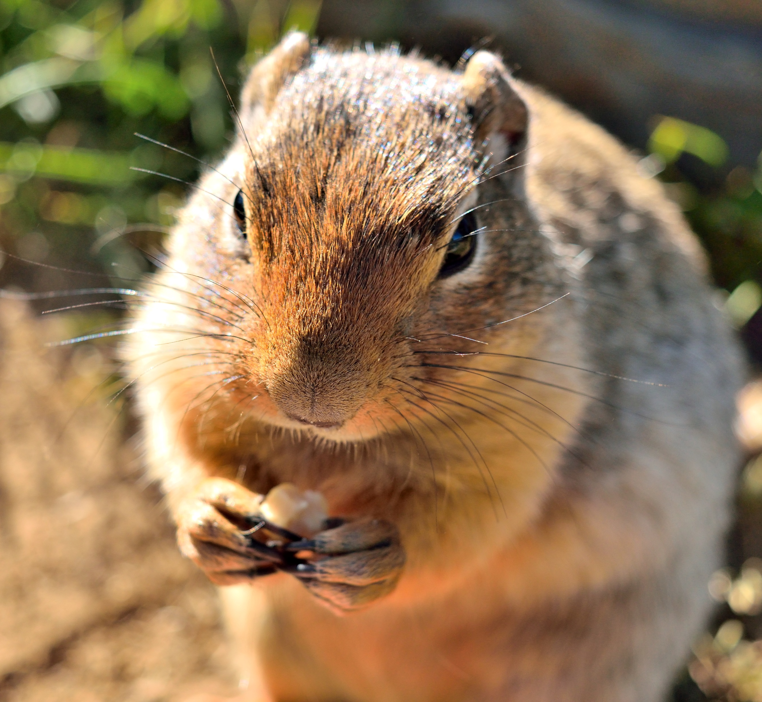
Lab 11: Deuterostomes Chapter 14

Slide 2
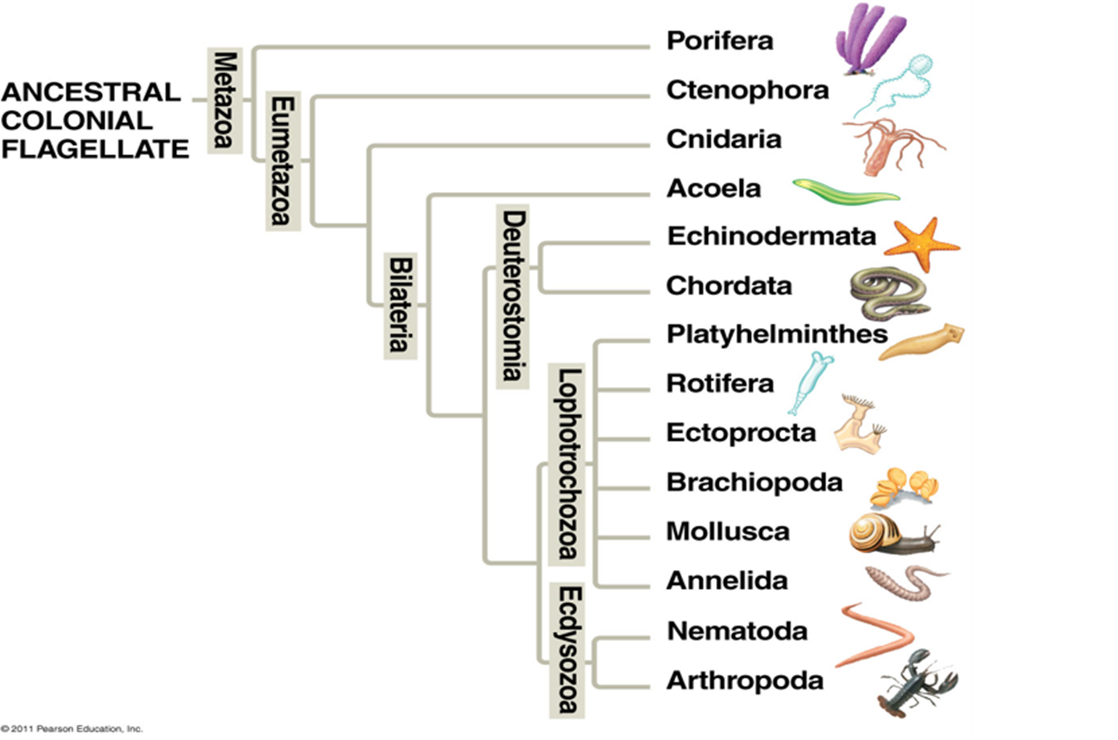
Deuterostomes
All deuterostomes follow similar early embryological development
Fertilized deuterostome egg cells divide and form a blastula, then they become a gastrula.
Deuterostomes form two openings in the gastrula
The first opening into the gastrovascular cavity becomes the anus.
The second opening becomes the mouth.

Slide 3
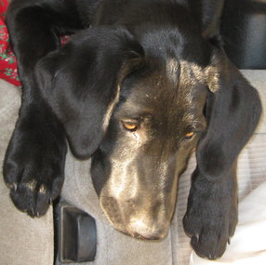
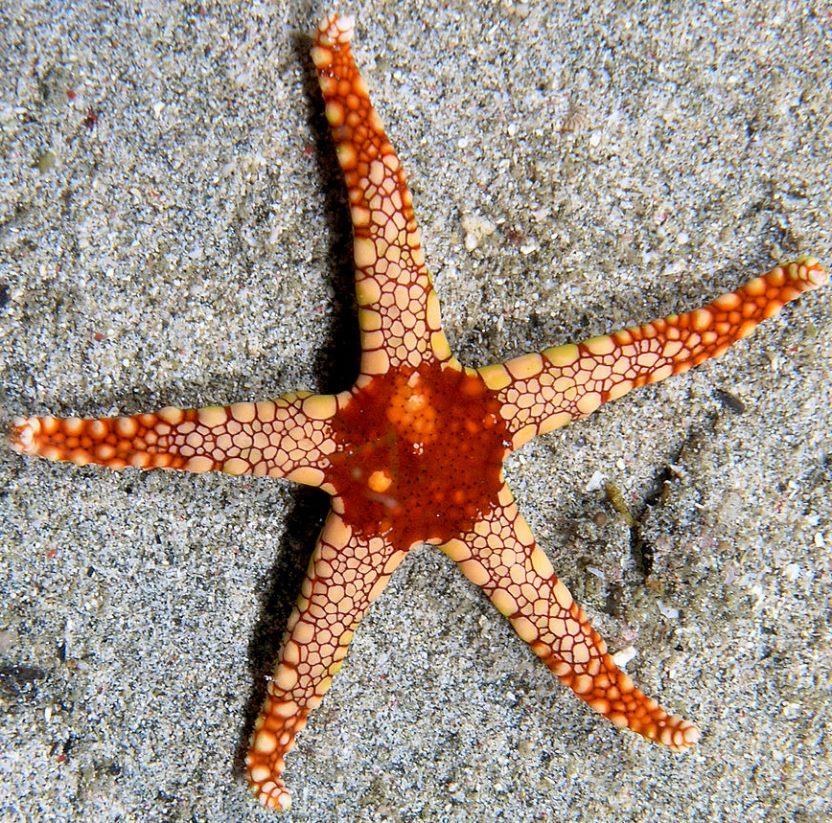
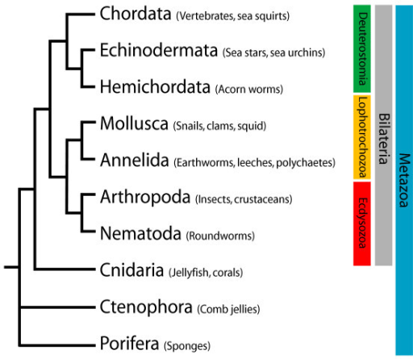
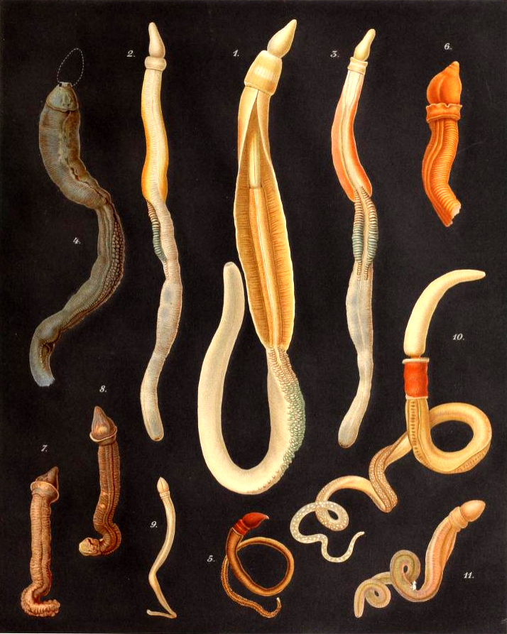
Deuterostome Phylogeny
By Nhobgood Nick Hobgood - Own work, CC BY-SA 3.0, https://commons.wikimedia.org/w/index.php?curid=6279893
File:Enteropneusta.png. (2018, March 17). Wikimedia Commons, the free media repository. Retrieved 18:34, November 13, 2018 from https://commons.wikimedia.org/w/index.php?title=File:Enteropneusta.png&oldid=292489626.

Slide 4
Echinoderms (Echinodermata)
Echinoderms start off as embryos with bilateral symmetry.
Early life is spent as a free-living larvae.
Free-living larvae undergo metamorphosis to the adult form.
All adult echinoderms have a derived radially symmetry.
The body plan is based on a five-fold symmetry best exemplified by the five-armed sea stars.
Usually, adult echinoderms have an endoskeleton of made up of calcareous plates under their thin skin.
Some echinoderms have long spines on their exoskeletons.
Some echinoderms are sedentary, but sea stars are active predators.
Sedentary echinoderms include sea urchins and sand dollars.
Sea stars feed on bivalves and corals.

Slide 5
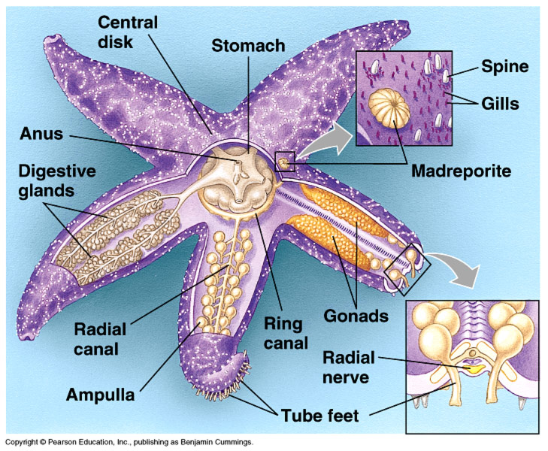
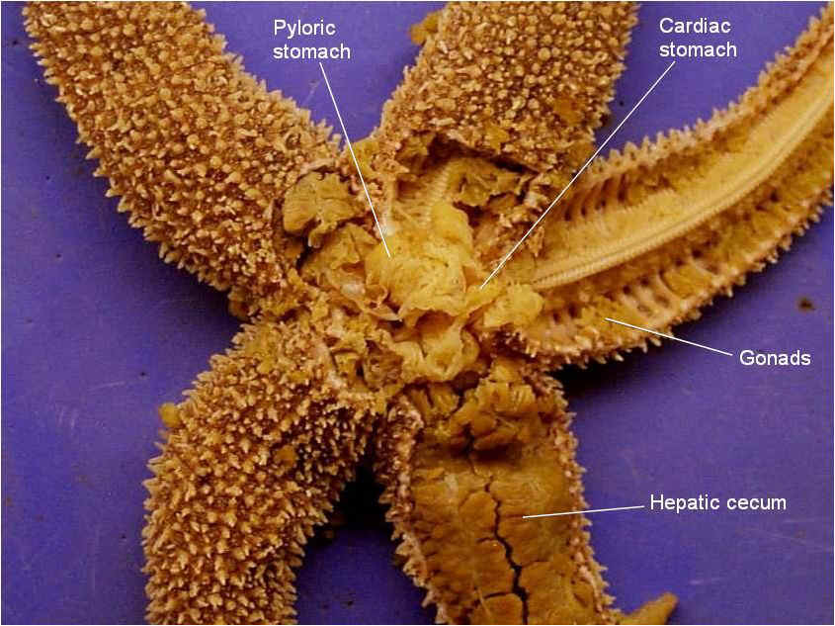
Echinoderm Anatomy

Slide 6
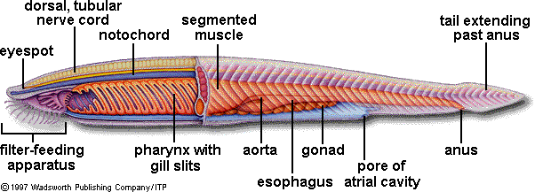
Chordates (Chordata)
Includes the largest and most complex species of animals (vertebrates)
Chordates have four main features for at least part of their lives:
Notochord
Hollow dorsal nerve cord
Pharyngeal slits
Post-anal tail

Slide 7
Chordate Features
Notochord- firm rod that acts as skeleton in simple chordates, becomes part of internal skeletal system in vertebrates
Dorsal hollow nerve cord- forms basis of nervous system, spinal cord
Pharyngeal slits- used for filter feeding in some chordates, modified for other uses in vertebrates
Post-anal tail- separate from abdomen, does not contain digestive tract

Slide 8
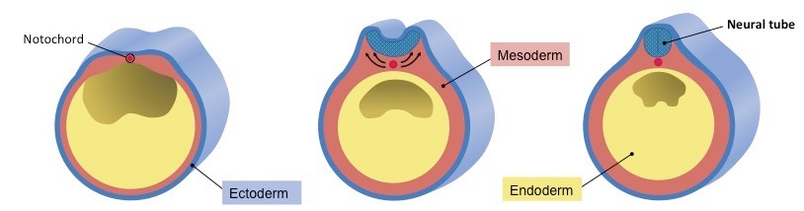
Chordates
The reason why chordates are able to be so large and complex is related to embryology.
On the dorsal ectoderm, the gastrula sinks down to form the neural groove.
The edges of the groove then fold up and inward, forming the hollow neural tube.
The neural tube is the beginning of the nervous system!
As neural tube forms, internal tissues become segmented
Tissue below the neural tube hardens into a firm rod known as the notochord.

Slide 9
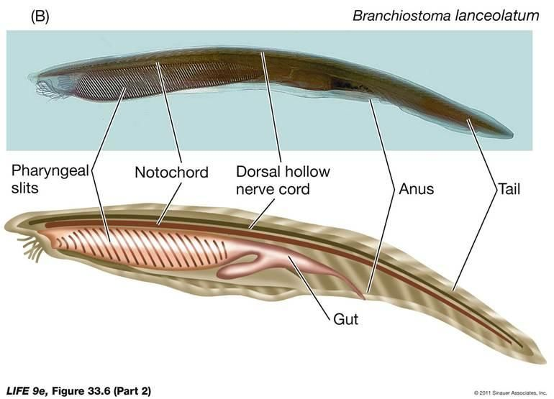
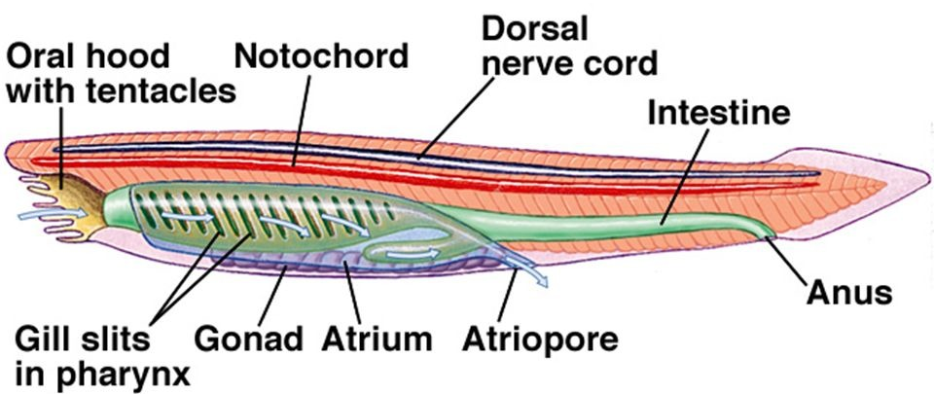
Cephalochordates (Lancelets)
Lancelets have the four characteristics of Chordata.
But it never forms the vertebral column, making them invertebrates
They are good swimmers, but tend to bury themselves in the sand with only their mouths above sand.
They filter feed (like the bivalves).
Bring water into their mouths and strain it through the pharyngeal silts
Expel excess water via the atriopore

Slide 10
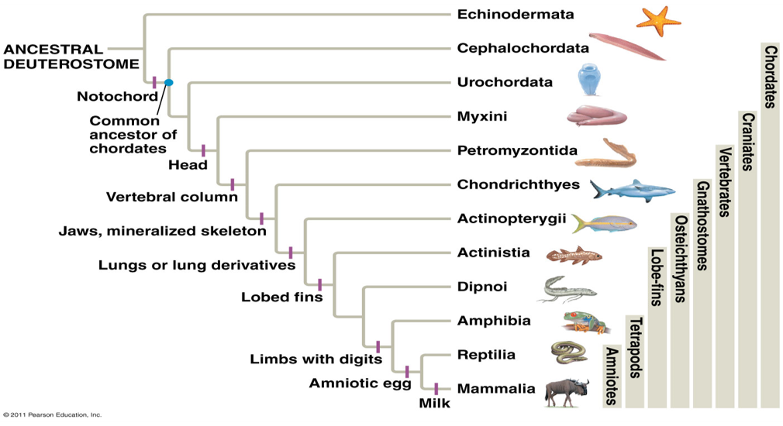
Deuterostomia Phylogeny

Slide 11
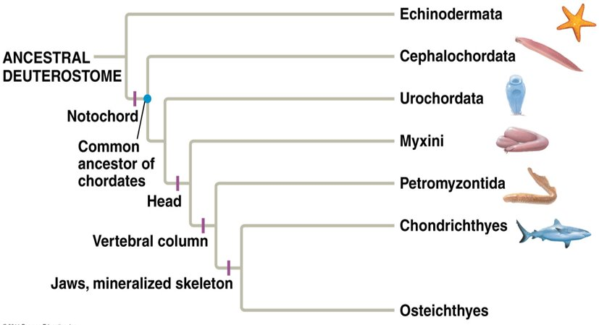
Vertebrata
In vertebrates, the notochord becomes the segmented vertebral column (backbone).
The oldest fossil vertebrates were fish covered with bony plates that lacked jaws.
The only jawless vertebrates extant (still living- not extinct) today are the lampreys and the hagfishes, which have cartilaginous skeletons and no appendages.

Slide 12
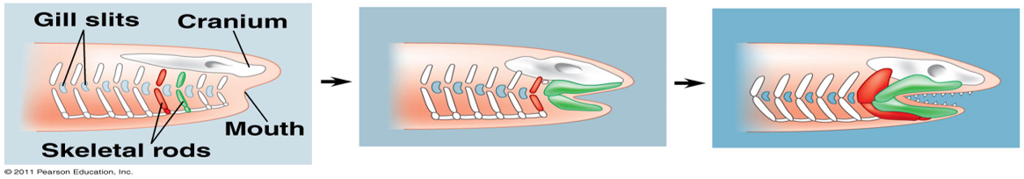
The Evolution of Jaws
The first vertebrates with jaws were the armored fishes.
Cartilaginous fish have hardened cartilage in between their pharyngeal slits that support the gill structure. These areas of hardened cartilage are gill arches.
A series of modified anterior gill arches become jaws.

Slide 13
Fish Anatomy
Well-developed brain (enlarged anterior end of nerve cord) with multiple lobes in the anterior region of body
Lateral line system- specialized sense organ that senses changes in water pressure and vibrations in the water found on the sides of fish
Operculum- flap of skin on the side of the head that is flapped back and forth to maintain a water current over the gills (sharks lack an operculum and must keep swimming almost constantly to maintain the water current over their gills)
Swim bladder- outgrowth of the pharynx that keeps the fish buoyant
Cloaca- combination anus and urogenital opening
Heart that uses one-way blood circulation
Circulatory system with blood in blood vessels

Slide 14
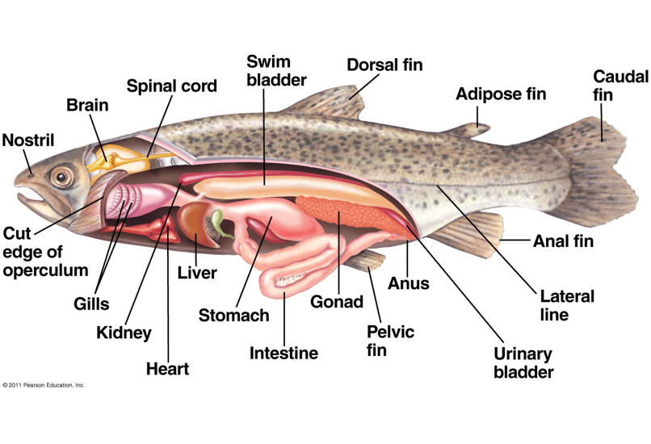
Fish Anatomy
Cloaca

Slide 15
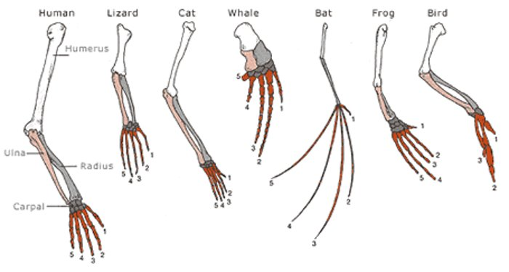
Terrestrial Vertebrates-Tetrapods
All terrestrial vertebrates had an ancestor that had four limbs. Most kept all four limbs, while others adapted to live without limbs or with only a single pair of limbs.
The tetrapod limb follows a basic pattern of 1-2-5: 1 long bone extending from the body to the first joint, then 2 bones that extend to the next joint, then at the end of the limb there are 5 sets of bones
In some tetrapods, groups of bones will be fused (such as in wings and hooves).
Example pattern: forelimb:
5 (phalanges in 5 digits)
2 (radius and ulna)
1 (humerus)
Notes:
Digits are bones at the end of a limb (ex. fingers or toes)

Slide 16
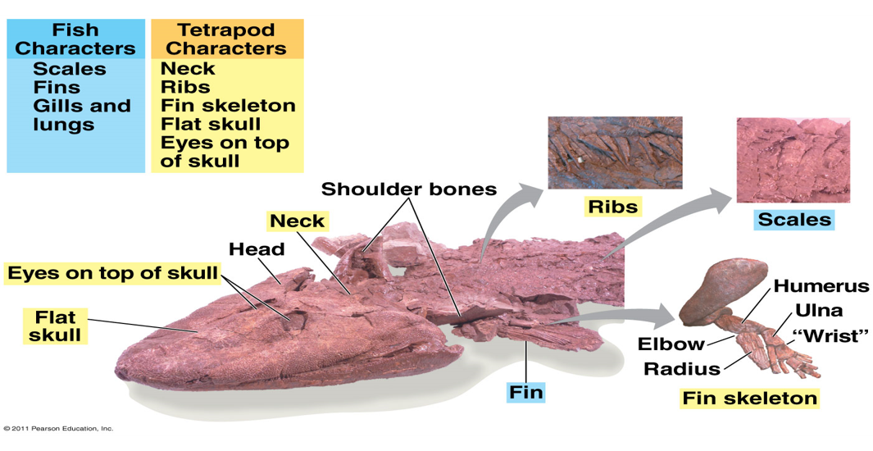
Terrestrial Vertebrates-Tetrapods
The first tetrapods evolved from fish. Tiktaalik was a fish with some tetrapod features; its discovery was important for our understanding of the evolution of land vertebrates.

Slide 17
1-2-5 Tetrapod Limb Pattern

Slide 18
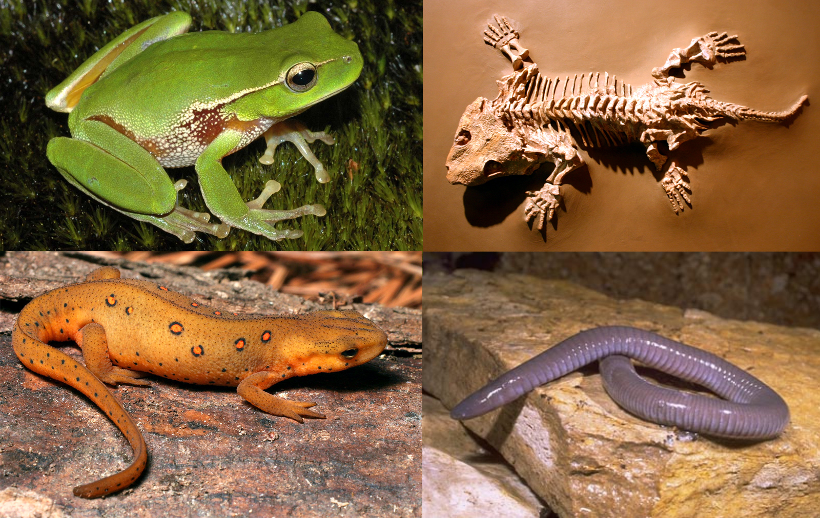
Amphibians
First vertebrates to transition to land
Limited to moist environments
Many of the adult amphibians have lungs and cutaneous respiration (gas exchange through skin).
In order for blood to be oxygenated efficiently, terrestrial vertebrates needed to develop double circulation (blood goes from heart to lungs to pick up oxygenated blood, then back to heart to pump to rest of body) to pump blood.
Amphibians are tied to water for at least part of their life-cycle, especially reproduction. Their eggs would dry out outside of water. The larvae are also usually aquatic.
File:Amphibians.png. (2016, November 17). Wikimedia Commons, the free media repository. Retrieved 10:12, November 12, 2018 from https://commons.wikimedia.org/w/index.php?title=File:Amphibians.png&oldid=214958305.

Slide 19
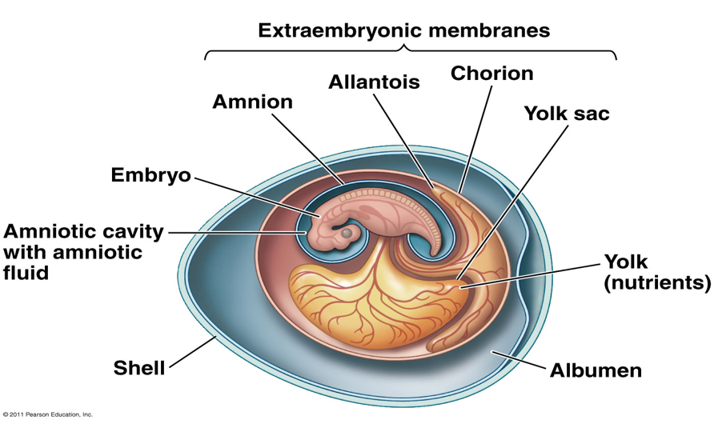
Amniotes
First fully terrestrial vertebrates
First appeared ~300MYA
Named for the amniotic egg
Amnion- extra membrane inside the egg that seals fluid in and keeps the embryo in a wet environment
Split off into two main lineages:
Mammals
Reptiles

Slide 20
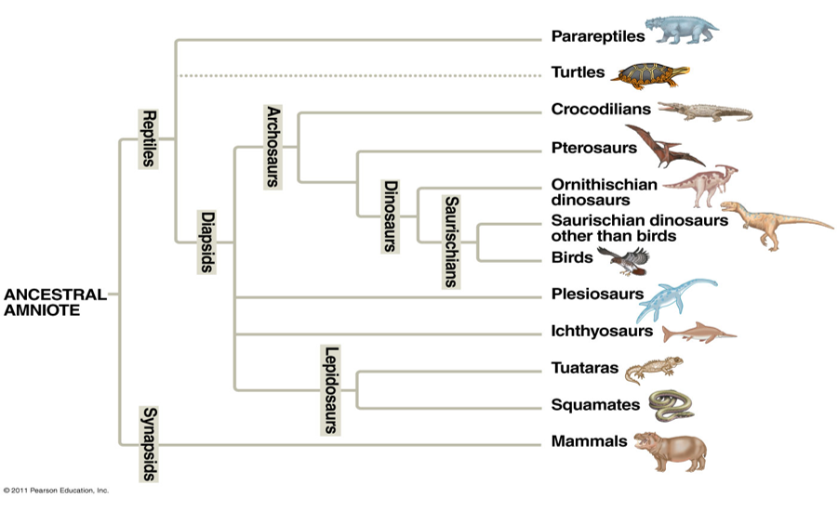
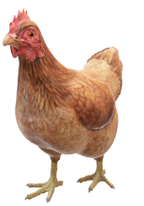
Which came first?
?
Amniotes with amniotic eggs evolved about 300 million years ago!
Chicken
Egg

Slide 21
Reptiles and Archosaurs
Reptiles have thick skin toughened with keratin
Keratin scales create an effective barrier to water loss
Most successful reptile group is the archosaurs
Crocodiles
Alligators
Dinosaurs
Birds
Archosaurs are more active, have higher metabolic rates, and have higher body temperatures than other reptiles.
Archosaurs will build nests and guard their young.

Slide 22
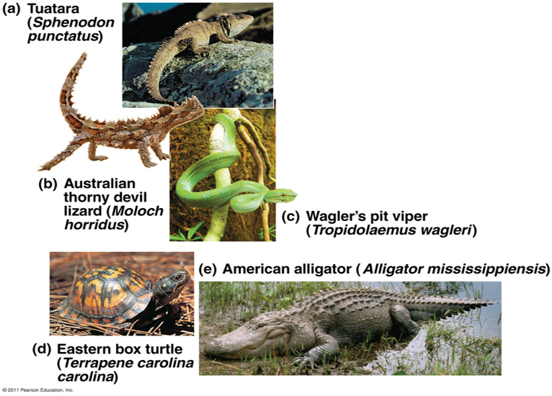
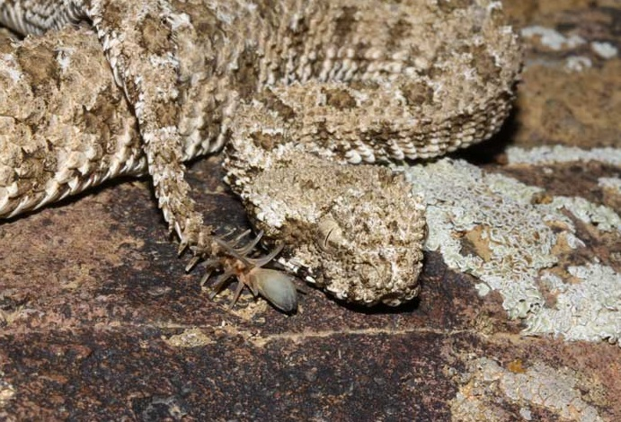
Non-Avian Reptiles
3-chambered hearts
Keratin scales
Spongy lungs that create more surface area for gas exchange (this is true for reptiles, bird,s and mammals)
spider-tailed horned viper (Pseudocerastes urarachnoides)
File:Pseudocerastes urarachnoides.jpeg. (2018, February 13). Wikimedia Commons, the free media repository. Retrieved 10:45, November 12, 2018 from https://commons.wikimedia.org/w/index.php?title=File:Pseudocerastes_urarachnoides.jpeg&oldid=286862608.
Notes:
Tuatara are not actually lizards, even though they look similar. They are the only extant (living) species from a different group of reptiles.

Slide 23
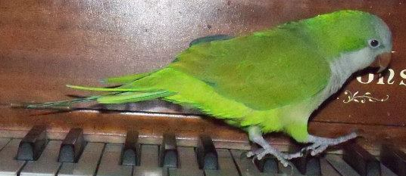
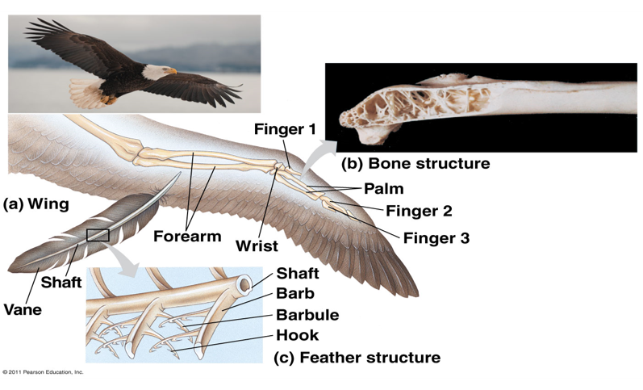
Avian Reptiles (Birds)
4 chambered heart
Keeps oxygenated and deoxygenated blood separate
High metabolic rate
Increases body temperature, so need to maintain high level of oxygen in blood
Keratin scales are modified into feathers
Feathers act as insulation and allow birds greater control over body temperature
Bones are specialized to be light-weight

Slide 24
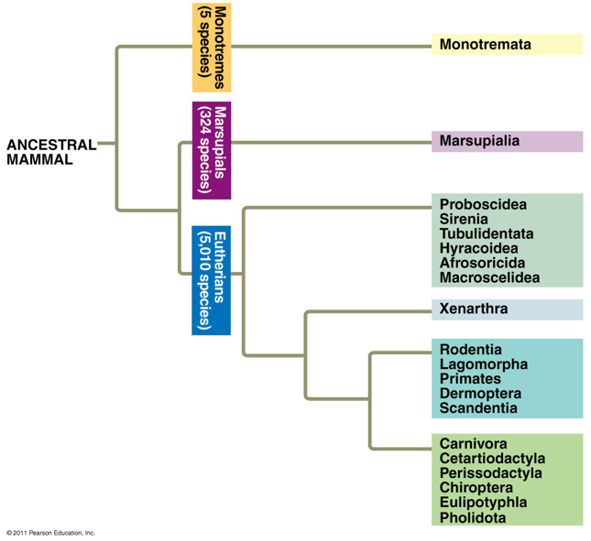
Mammals
4 chambered hearts
Have hair: keratin-based structures (develops from the same embryological skin structures that scales and feathers are formed from)
Hair acts as an insulator, but is not as effective as feathers

Slide 25
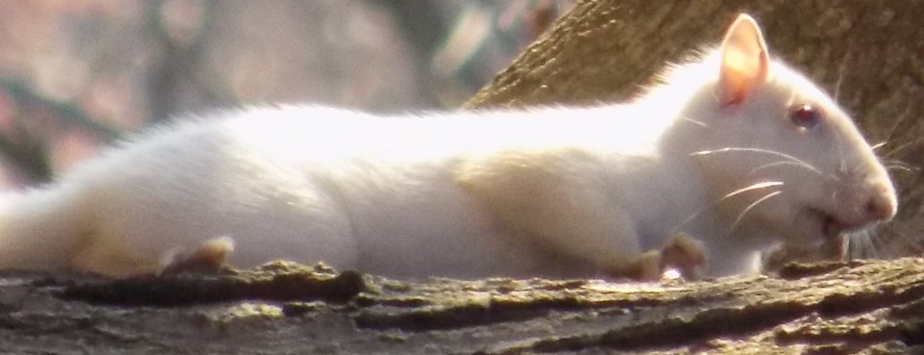
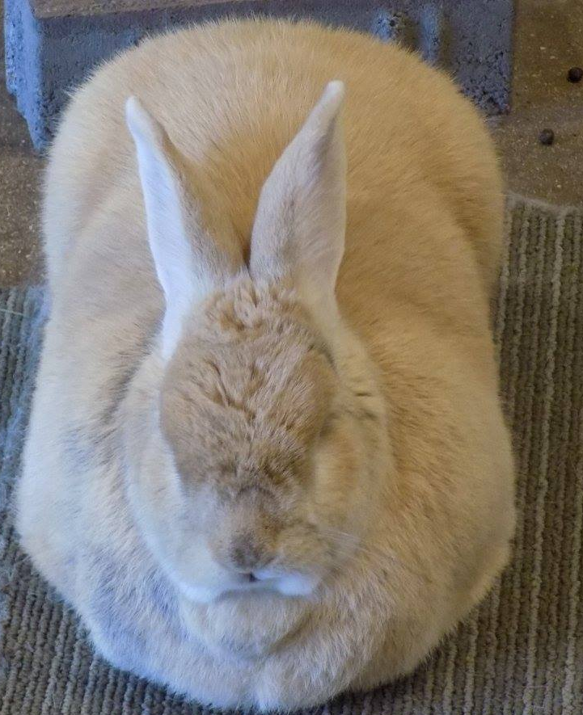
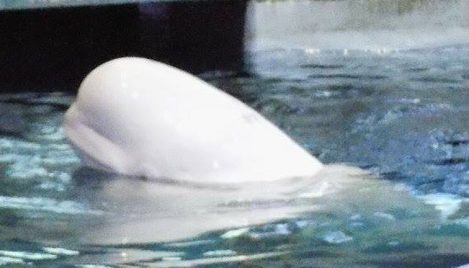
Mammals
Mammals can overheat and have sweat glands as a way to thermoregulate (control body temperature)
Modified sweat glands are the basis for mammary glands
Mammary glands produce protein and sugar-filled fluid known as milk
Milk is delivered via specialized structures known as nipples (monotremes lack nipples but have milk-producing patches of skin)
Mammals have muscular faces and lips in order to nurse

Slide 26
Lab Activities
The lab is provided in the worksheet for this week on Blackboard.
Investigation 1: Echinoderms
Sea Star embryology: Examine the images of sea star development. Identify the blastula and gastrula and state the difference between the two.
Echinoderm Diversity: Look at the pictures of different echinoderms and identify the type of symmetry they have. Draw the axes of symmetry on one of the pictures.
Investigation 2: Invertebrate Chordates
Examine the images of Amphioxus and compare it to Figure 14.2 from your lab manual. Write about any segmentation in Amphioxus.
Look at the lancelet cross section. Try to find the nerve cord and notochord. Use Figure 14.2 for help.

Slide 27
Lab Activities, Continued.
Investigation 3: Perch Dissection
Follow the link provided in the lab activity PowerPoint. Make a diagram of the exterior of the fish. Label the fins, operculum, and lateral line. Also draw the interior of the fish. Label the gills and digestive system. You can use Figure 14.3 from your lab manual to help with this. You also have the option of watching the video of a perch dissection (link in lab activity PowerPoint). Follow along with it and draw the parts of the perch anatomy.
Investigation 4: Survey of Terrestrial Vertebrates
Look at the pictures of vertebrate limbs. Count the number of bones in each segment. Do they follow the same pattern? Do any look fused? You can use Figure 14.4 as a reference.
Look at the pictures of skins of vertebrates. Compare the different body coverings of mammals, reptiles, and birds. Do you see any similarities between bird feathers and reptile scales?

